Slide 1
Uncategorized

Slide 2
Ransomware Unification - Replace Ransomware signature source with reputable threat intel source
Confluence page:https://egnyte.atlassian.net/wiki/spaces/DEL/pages/1425834012/Ransomware+Unification+-+Replace+Ransomware+signature+source+with+reputable+threat+intel+source
View in Productboard
DEL-44545
Missing requirements

Slide 3
Migrate Data from SPO to Egnyte - GA
Migrate data from Sharepoint Online to Egnyte using our Content Lifecycle product. Define what GA means for this product. Must be available to some or all customers to self-serve.
View in Productboard
No Jira Link
Missing requirements

Slide 4
DocuSign Upload Enhancement
(Blocked at DocuSign side, might slip to Q3)The current integration with DocuSign utilizes API version 2.0, which restricts file uploads to a maximum size of 25 MB. This limitation is causing issues for customers attempting to share larger files. To address this problem, we need to upgrade to DocuSign API version 2.1, which supports file uploads up to 32 MB via APIs and up to 52 MB via chunked uploads. Additionally, we will implement a user interface enhancement to notify users when they attempt to upload files that exceed the allowed size limits. This upgrade will improve file sharing capabilities and user experience.
Acceptance Criteria:
1. Upgrade to DocuSign API version 2.1 and ensure compatibility with the current integration.
2. Implement support for handling files up to 52 MB using chunked uploads.
3. Develop and deploy a pop-up notification feature to alert users when attempting to upload files larger than the allowed limits.
4. Perform thorough testing to validate the new functionality and pop-up notifications.
5. Update documentation to reflect the changes and new file upload limits.
Links:https://developers.docusign.com/docs/esign-rest-api/esign101/rules-and-limits/#:~:text=Docusign%20has%20the%20following%20limitations,of%20up%20to%2052%20MB
https://developers.docusign.com/docs/esign-rest-api/reference/envelopes/chunkeduploads/
Ticket:https://jira.egnyte-it.com/browse/PINT-15240
View in Productboard
No Jira Link
Missing requirements

Slide 5
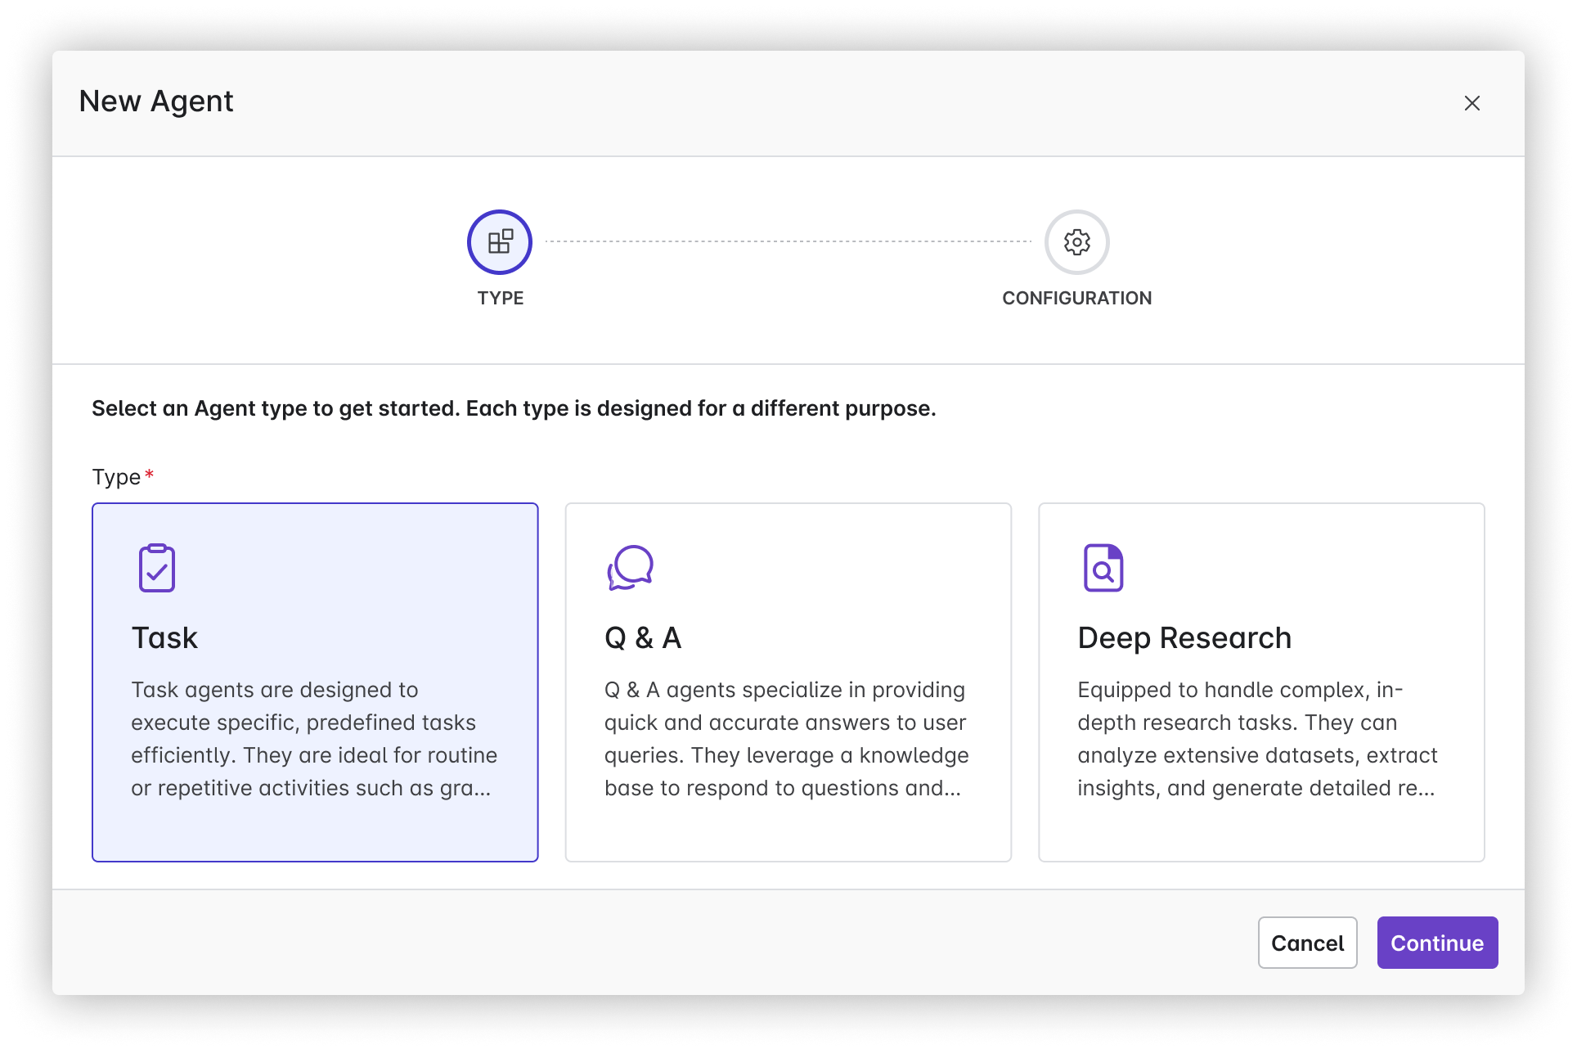
[Agent] Deep Research Agent (Bryce)
Problem Statement
Businesses and researchers often struggle with the time-consuming task of conducting in-depth analysis and research, such as finding historical data or identifying trends from previous projects. This lack of efficiency can delay decision-making processes, harming productivity.
User Story
As a business analyst, I want a Deep Research Agent that can quickly identify similar proposals and investments by analyzing historical data, so that I can accelerate the research process and make more informed decisions based on past trends.
Value Statement
• Time Savings: Automates the labor-intensive process of sifting through historical data, drastically reducing the time spent on research from months to mere days or hours.
• Increased Productivity: Allows employees to focus on higher-value tasks by automating repetitive research activities.
• Cost Efficiency: Reduces the need for extensive manual labor, resulting in lower operational costs associated with research and analysis.
View in Productboard
CFS-67394
Link to requirements

Slide 6
Presto Portal For Partners
The description is empty.
View in Productboard
No Jira Link
Missing requirements

Slide 7
Model DB Refactoring for Scale
The description is empty.
View in Productboard
GR-597
Missing requirements

Slide 8
Domain Without Trial - Additional Use Cases
The description is empty.
View in Productboard
No Jira Link
Missing requirements

Slide 9
Complete revamp of Egnyte developer portal
For the below we have already started the discovery of right tool for documentation, currently we are talking with APIdog, Theneo, Document360 (https://egnyte.atlassian.net/wiki/spaces/PINT/pages/1429864598/AI-Powered+Tools+for+Generating+API+Documentation) :
TheEgnyte Developer Portalwill undergo a complete revamp to enhance usability, improve API documentation, and provide a more seamless experience for developers. The new portal will feature an intuitive interface, updated guides, and better support for integrations with Egnyte services. This update aims to streamline API adoption, making it easier for developers to explore, test, and implement Egnyte’s capabilities in their applications.
Additionally,AI-powered searchis will be looked upon in the portal to improve content discoverability. This advanced search functionality will leverage AI to provide more relevant results, intelligently surfacing documentation, code snippets, and troubleshooting guides based on user queries. The goal is to reduce friction in finding information and improve developer productivity by offering precise and contextual search results.
These enhancements will provide a more user-friendly and efficient platform for developers, driving better engagement and faster integration with Egnyte’s ecosystem.
View in Productboard
No Jira Link
Missing requirements

Slide 10
Link Throttling Removal Propagation
Background and strategic fit
Certain customers are running into API limits, When that happens they tend to call support for a solution and not their sales account manager.
In many cases the issue is urgent for the customer and they are asking for a quick remediation and the only option support has for them is to ask for approval of a one time reset of the API limit.
In future cases no one checks if the same customer repeats the ask.
Goals
• Provide support the means to direct customer an immediate solution that costs money
• Open the door for additional revenue by charging for such a solution without providing a free reset
Proposed Solution
• Add "removal of link throttling" to self serve option on plan details.
• The SKU exist and costs $250/domain per month
• Customer should be able to cancel the feature after one month.
• Available for all platform plans beside Enterprise and Enterprise-Lite (Because these don't have throttling limitations)
Requirements
||#||Requirement||Description||Importance||Notes|||1|Add New Service Line Item|Service name will be called "Removal of Link Throttling" in the Billing App. Will be a flat fee of $250 per domain per month.|Must have| ||2|Plan Details Page Update|Item should be visible on PDP for self-service.|Must have| ||3|Service Enabled|Once service is enabled, Throttling (HS Max Download) will not take place|Must have| ||4|Script|Only provide to domains that do not have it already enabled and should have it as an optional item|Must have| |
Questions
Below is a list of questions to be addressed as a result of this requirements document:||Question||Outcome|||If user tries to cancel feature before one month, what is the expected behavior? |TBD|
Resource
Report link removalhttps://egnyte.my.salesforce.com/00O8Y000008GG8t
!image-2024-01-29-18-11-00-646.png!
View in Productboard
APPS-9447
Link to requirements

Slide 11
Feature Entitlements Q3 2025
Problem StatementWe are looking to propagate features out the necessary plans in the quarter.
User StoryAs a product manager, I want to release my feature through the Billing App, so that I can help Egnyte grow.
Feature Description
• We are propagating features to the proper plans through the plan service job
View in Productboard
APPS-13951
Link to requirements

Slide 12
Increasing the file size limit of google slide files
https://jira.egnyte-it.com/browse/PINT-17248Google confirmed the 100 mb limit earlier on an older escalationhttps://partnerissuetracker.corp.google.com/issues/267782863
We have updated the documentation:https://helpdesk.egnyte.com/hc/en-us/articles/360028093372-Egnyte-for-Google-Workspace#h_6a5777d7-27e5-4654-9f6e-73e02050008c
Improvement: We have to increase the file size limit of the google slides.
Reference SER:https://jira.egnyte-it.com/browse/SER-3360
View in Productboard
No Jira Link
Missing requirements

Slide 13
G Doc Share Add On in Iframe
Update Share Addon to Open Within Iframe Instead of New Tab:Update the current implementation of the Share Addon so that the sharing interaction occurs within the iframe of the host application, rather than redirecting users to a new browser tab or window. This change is intended to maintain continuity of experience and improve user engagement by avoiding disruptive navigation.
View in Productboard
No Jira Link
Missing requirements

Slide 14
Webhook Improvements
This is a known issue as reported in a customer ESC. We provided a patch fix but it has to be addressed at the root cause level. It holds the high value because of its high usage.
View in Productboard
No Jira Link
Missing requirements

Slide 15
Egnyte Cloud Agent - Phase 3
CMM/S&G Integration - Phase 3
As part of phase 1, 2 points covered
• CMM Agent Installer should be able to register in S&G Env
• Once installed, it should reflect meta data of customer machine on CMM UI
• Permissions and local users/groups should also be reflected
• Migration should be allowed for this source.
• Remediation
• DPC
• AD onnectore
As part of phase 3
• Custom migration
• Event driven
• Delta snapshot
View in Productboard
EMT-12573
Link to requirements

Slide 16
GDoc V4 Improvement
Enhance the value of the integration for our LA and GA customers by implementing key improvements, including replacing the webhook with the Drive Event API as recommended by the Google team, improving the visual interface of the Google add-on to display the Egnyte share menu, increasing the file size limit for Google Slides, and updating the Node.js version if necessary.
View in Productboard
No Jira Link
Missing requirements

Slide 17
Filter files before sending to DocAI
Problem Statement
We have implemented the ability to use Google DocAI as the OCR engine for S&G classification. However, it is an expensive service. We need to look at ways that we can limit the files that we send through DocAI to only those files that need to
User Story
As an Egnyte employee, I want to be sure that we control costs as much as possible without impacting the capabilities that we promise our customers
Feature Description
• Create filter to identify files that should go through Doc AI vs files that only need to go through our existing OCR engine (Apache Tika)
View in Productboard
DEL-45773
Link to requirements

Slide 18
Deployment Accuracy Spillover - "Is Obsolete" Functionality
Problem Statement:
Currently, there is not a great way to properly sunset features within the Billing App.
User Story:
As a Billing App user, I want to have the ability to mark a service as "obsolete", so that we can properly deprecate features.
Feature Description:
• Marking a feature obsolete within the Billing App
• Prevent obsolete features from being provided to new & cloned PVIs
View in Productboard
APPS-13773
Link to requirements

Slide 19
Elevated Desktop App Capabilities

Slide 20
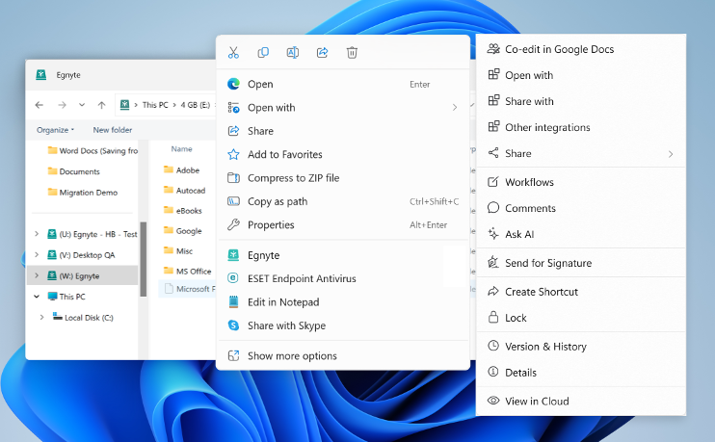
Windows 11 Context Menu Support
Problem Statement
Windows 11 moved the regular File Explorer context menu behind a "Show more options" menu and introduced a new context menu. Users cannot find the Egnyte context menu and this reduces engagement with richer functionality.
User Story
As a user I want the Egnyte context menu to be available on the top-level File Explorer context menu so that I interact with my Egnyte files directly from the desktop.
Feature Description
• Egnyte option will be exposed on the top-level File Explorer context menu
• Clicking the Egnyte option will open the Egnyte Actions "menu", providing access to a wide variety of file-level actions (link sharing, Ask AI, eSig, PDF editing, etc.)
View in Productboard
EGD-21555
Link to requirements

Slide 21
Adaptive Block Cache for Mac
Adaptive Block Cache enables video editors and media designers to work on large media projects directly on Egnyte. This will drive business (upsell) esp. from existing media customers where a small subset of their users use other tools like LucidLink or external drive to work on large media files
View in Productboard
No Jira Link
Missing requirements

Slide 22
Differential Sync on v2 files
Customer domains have large v2 files. Allow Adaptive Block Cache to perform differential sync on the existing v2 files
View in Productboard
No Jira Link
Missing requirements

Slide 23
Adaptive Block Cache for Windows Beta-2
The next phase of Adaptive Block Cache for Windows enables us to reach out to a larger set of AEC customers. We've enhanced ABC on Windows to support more AEC applications:
• Navisworks
• ArcGIS
• Microstation
• Rhino
In addition, we support MS Co-edit
View in Productboard
No Jira Link
Missing requirements

Slide 24
Client Upload using V4
Desktop, Web and Hybrid clients need to upload v4 files in order for ABC to work
View in Productboard
No Jira Link
Missing requirements

Slide 25
Workflow Enhancements

Slide 26
eSignature template links
Problem Statement
Users who need to send a document for signature to a large number of people whose email address is unknown, cannot send the requests.
User Story
As a sender of signature requests, I want to create a URL for a template and paste them in public spaces (slack channels, website, public disclaimers etc.) so that people can access that link and create signature requests for themselves by entering their email.
Feature Description
• Use a template to send signature requests to a person who has access to the link.
• The user needs to click on the link and it will open Egnyte interface wherew they can mention their email id and a signature request will be generated based on that template.
• This is applicable for a single placeholder (role) templates.
View in Productboard
No Jira Link
Missing requirements

Slide 27
Upload request instance modification from template
Problem Statement
The upload request template cannot be modified at all while creating an upload request instance. The customers would like to remove specific document(s) or mark them optional while creating a request instance.
User Story
As an Egnyte Domain user, I would like to modify the documents from a template while creating an upload request so that I can modify the existing template to request specific documents based on specific criteria.
Feature Description
• While creating an upload request instance, allow users to mark a document as optional or remove the document from a template.
• Provide a setting in the template to control the modification action while creating an upload request instance.
View in Productboard
CFS-67186
Missing requirements

Slide 28
Augment AEC Add-on Value

Slide 29
[AEC] Deltek Vantagepoint Connector
When a project is created in Deltek vantagepoint, I would like a project folder to automatically be created in Egnyte.
Requirements -https://egnyte.atlassian.net/wiki/spaces/AEC/pages/1223622717/Deltek+Vantagepoint+Integration
View in Productboard
EMT-13700
Missing requirements

Slide 30
[AEC] BIM Preview Tech Debt
New enhancements for Q3
• Rearchitect how we handle BIM viewer to optimize ODA library updates.
Delivered:
Problem:
Upgrading library versions has taken months due to our current architecture.
User Story:
Description:
View in Productboard
SRV-2516
Link to requirements

Slide 31
Persona Capture & Recommendations

Slide 32
Recommendation Engine Model Development
Break into the Model Versions & Phases
What did we do in Q2?
What are we working on in Q3?
Break it out and focus on Q4
View in Productboard
No Jira Link
Missing requirements

Slide 33
[PLG - 1] Training the Model: Enable Model Testing for Persona Recommendations
AKA Recommender MVP Refinements
Minor refinements needed to complete our MVP of the Recommender.
1. SQL Update: SQL Query is written so that we can’t do an update/change in the DB if there are multiple entries for the same domain (even for different users.)
2. Logging: Right now we can’t track what is happening. Need logs on the back end side.
3. New User Recognition: If user has not yet accepted their invitation to the domain and the recommender is loaded with a suggestion for that user, they will never see the recommendation. Is there a way to ensure the recommender recognizes new users?
4. Tracking
• Users who click on “You have recommendations…”
• Users who click on Learn More, Got it, Not Interested
• Users who navigate from Explore to Copilot (does this increase utilization of Copilot?)
• Track increased Copilot usage
• Track increased usage of recommended feature
5. UI: Allow use of static images instead of video (make the "play button" optional)
6. UI: Introduce better language on the Copilot UI panel for users that don’t have Copilot enabled.
7. Find alternative to Mixpanel for tracking user behavior. We have recently discovered Mixpanel does not work if an ad blocker is in use on the browser. This renders our reporting inaccurate.
See Confluence:Alba Application Requirements
View in Productboard
GR-602
Missing requirements

Slide 34
Recommendation Engine Test Campaigns
Continue testing the Recommender against Pendo in a series of campaigns.
View in Productboard
GR-578
Missing requirements

Slide 35
[PLG] Recommendations on Home Page
The description is empty.
View in Productboard
No Jira Link
Missing requirements

Slide 36
Augmented Metadata

Slide 37
[Metadata] Classify all files under AEC project folders (Spillover)
Problem
AEC customers have asked to classify all the files that get uploaded into their project folders.
Classification opens up use cases such as easy retrieval and discovery of content based on document type. Customers have thousands of archived projects that contain requirements, proposals, detailed drawings, estimates etc. When they are starting a new project, it is extremely valuable to be able to find data from similar past projects (e.g. find all old proposals for projects in earthquake zones, etc). Classifying all files and extracting relevant entities from them will allow for easy search through their old projects.
User Story:
As an AEC project manager, I want to classify all the files uploaded inot my project, so that I can easily search, filter, and create views based on file types (RFI, proposal, etc.)
Description
• Classify every file that is uploaded into a project folder
• Use AEC specific document classes (see this page for a list -https://egnyte.atlassian.net/wiki/spaces/AEC/pages/1112866940/AEC+Doc+Types+-+Extraction+Prompts
View in Productboard
No Jira Link
Link to requirements

Slide 38
[Metadata] Metadata Driven View - (Spillover) + Save/Share views
Objective -
• Empowers users to leverage tags for easily customize their viewing experience
• Allow users to create, save, and share views that leverage tags
• Make tags easier to consume and hence make our product more sticky
Overview -
This is a combination of any spillover work from Q1 plus phase-C of this project (save/share views)
The feature is divided into 3 phases
• Phase-A - Only show relevant tags.
• Phase-B – Inline editing of metadata, search in columns (properties with values)
• This piece is dependent on datagrid 2.0 migration.
• Phase-C – Save/share views.
Phase A and B are expected to be complete in Q1. If there is any spillover, it will be handled via this Q2 feature.
Seehttps://egnyte.atlassian.net/wiki/spaces/CFS/pages/631964095/13.+Metadata+driven+Viewsfor detailed requirements
View in Productboard
No Jira Link
Link to requirements

Slide 39
[Metadata] Unify tags from multiple classifiers and resolve classifier conflicts
Placeholder
• Unify the tags being created by multiple classifiers
• Store the provenance of tags and display to the user
• Implement rules on tag precedence
• [Stretch?] Feedback learning based on user tag modification
View in Productboard
No Jira Link
Link to requirements

Slide 40
Build Pax8 Distributor Program

Slide 41
Distributor - Automation phase 3 - Existing Resellers migration to Pax8
Problem Statement
This effort is to support migration of existing MSPs, who currently work with Egnyte, to be managed by Pax8.
On the Pax8 side this process is called 'change of channel' and requires that the MSPs specifically requests in the Pax8 marketplace platform to move its customers to Egnyte. This is done for each customer separately.
When such a request for specific MSP is received by SFDC it will only be send downstream if requests are sent over for ALL the customer domains we currently have registered at Egnyte.
It is assumed that the whole MSP is switched to be managed by Pax8. There is no support for managing some customer domains with Pax8 and some with Egnyte.
User Story
As MSP currently working directly with Egnyte I want to transition to Pax8 Marketplace platform so that I can manage my business from there.
Feature Description
• allow automated support for the processes of migrating MSPs to be managed by Pax8
• prepare technical documentation so it can be shared with SFDC teams for integration purposes
• maintain current flows for Reseller events
View in Productboard
APPS-13842
Link to requirements

Slide 42
Distributor - Change of distributor/billing system
Problem Statement
Building integration with Pax8 is only creating a model to manage distribution at Egnyte. We're aiming to provide the possibility to switch to another Distributor (not yet known) or to go back to Egnyte and be billed by SFDC (preferably) or Billing App.
User Story
As a PAx8 Managed MSP I want to be able to go back to cooperating directly with Egnyte or to switch to another Distributor.
Feature Description
1. Allow to add another Distributor - most preferably it should be configuration only with the assumption that integration with the new distributor is done through SFDC as well and same mechanisms for automatic deployments are used
2. Allow to switch MSP from Distributor back to Egnyte
View in Productboard
APPS-13485
Link to requirements

Slide 43
Distributor - Automation phase 4 - Advanced transactions
Problem Statement
More advanced updates for partners and domains are currently not available for self-serve and are mostly manual internal operations. This epic is to provide automation for such cases to streamline processes.
User Story
As Egnyte Internal system I need to provide automated deployment for Pax8 Managed MSPs so that deployment requests can be done without manual support from the Finance Team.
Feature Description
1. Prepare design for automation of the processes for Pax8 Managed MSPs and preferably for other types of partners
2. List the changes needed, prepare documentation
3. Allow automated support for the processes:
• cancellation of a trial
• cancellation of a child domain (deprovision)
• extending a trial
• resuming a trial
• cancelling a trial
• change in subscription
• change of channel (direct to partner and vice versa)
• change of partner
View in Productboard
APPS-13730
Link to requirements

Slide 44
Distributor - Enhancements
Problem Statement
Integration with Pax8 is being worked on based on the scope agreed with all parties. As we progress there might be new ideas and enhancements worth adding to support cooperation with distribution channel.
User Story
As a Pax8 Managed MSP I want to be supported during cooperation with Egnyte by Egnyte so that I can learn more about the products and operate smoothly to satisfy my end customers.
Feature Description
1. Provide resources on Egnyte products (plans and features) for partners so that MSP managed by Pax8 can introduce Egnyte own customers to Egnyte with ease and confidence.
2. Adjust welcome email sent to new MSPs coming from Pax8 so that they understand they need to setup the MSP Reseller Dashboard account and how to use it.
View in Productboard
APPS-13887
Link to requirements

Slide 45
Specialized Agents

Slide 46
[Agent] Codebooks Agent for AEC
Problem:
Users in the AEC industry require to follow regulations and standards during the design / construction / maintenance of structures and these are stipulated as building codes. These building codes are extremely long, detailed and complex, can vary by local jurisdictions and can change from year to year. Due to these factors, users often face the challenge of finding the right code information pertaining to a project, and using that information to validate project specifications, submittals and other project docs.
Use-Cases:
1. As a project engineer / field engineer, I want to easily get answers to regulatory questions, such ashow many ADA accessible parking spots do I need if my parking lot has 100 total parking spaces?
2. As a project coordinator, I want to easily validate a spec against regulations/codes- validate this stairwell design for fire safety regulation compliance
Description:
We will create a specialized agent, the code books agent, which the admin can configure to read one or more code books at a specific location on their Egnyte domain. Once configured, users can ask questions against the code book agent from the WebUI or desktop
View in Productboard
CFS-64858
Link to requirements

Slide 47
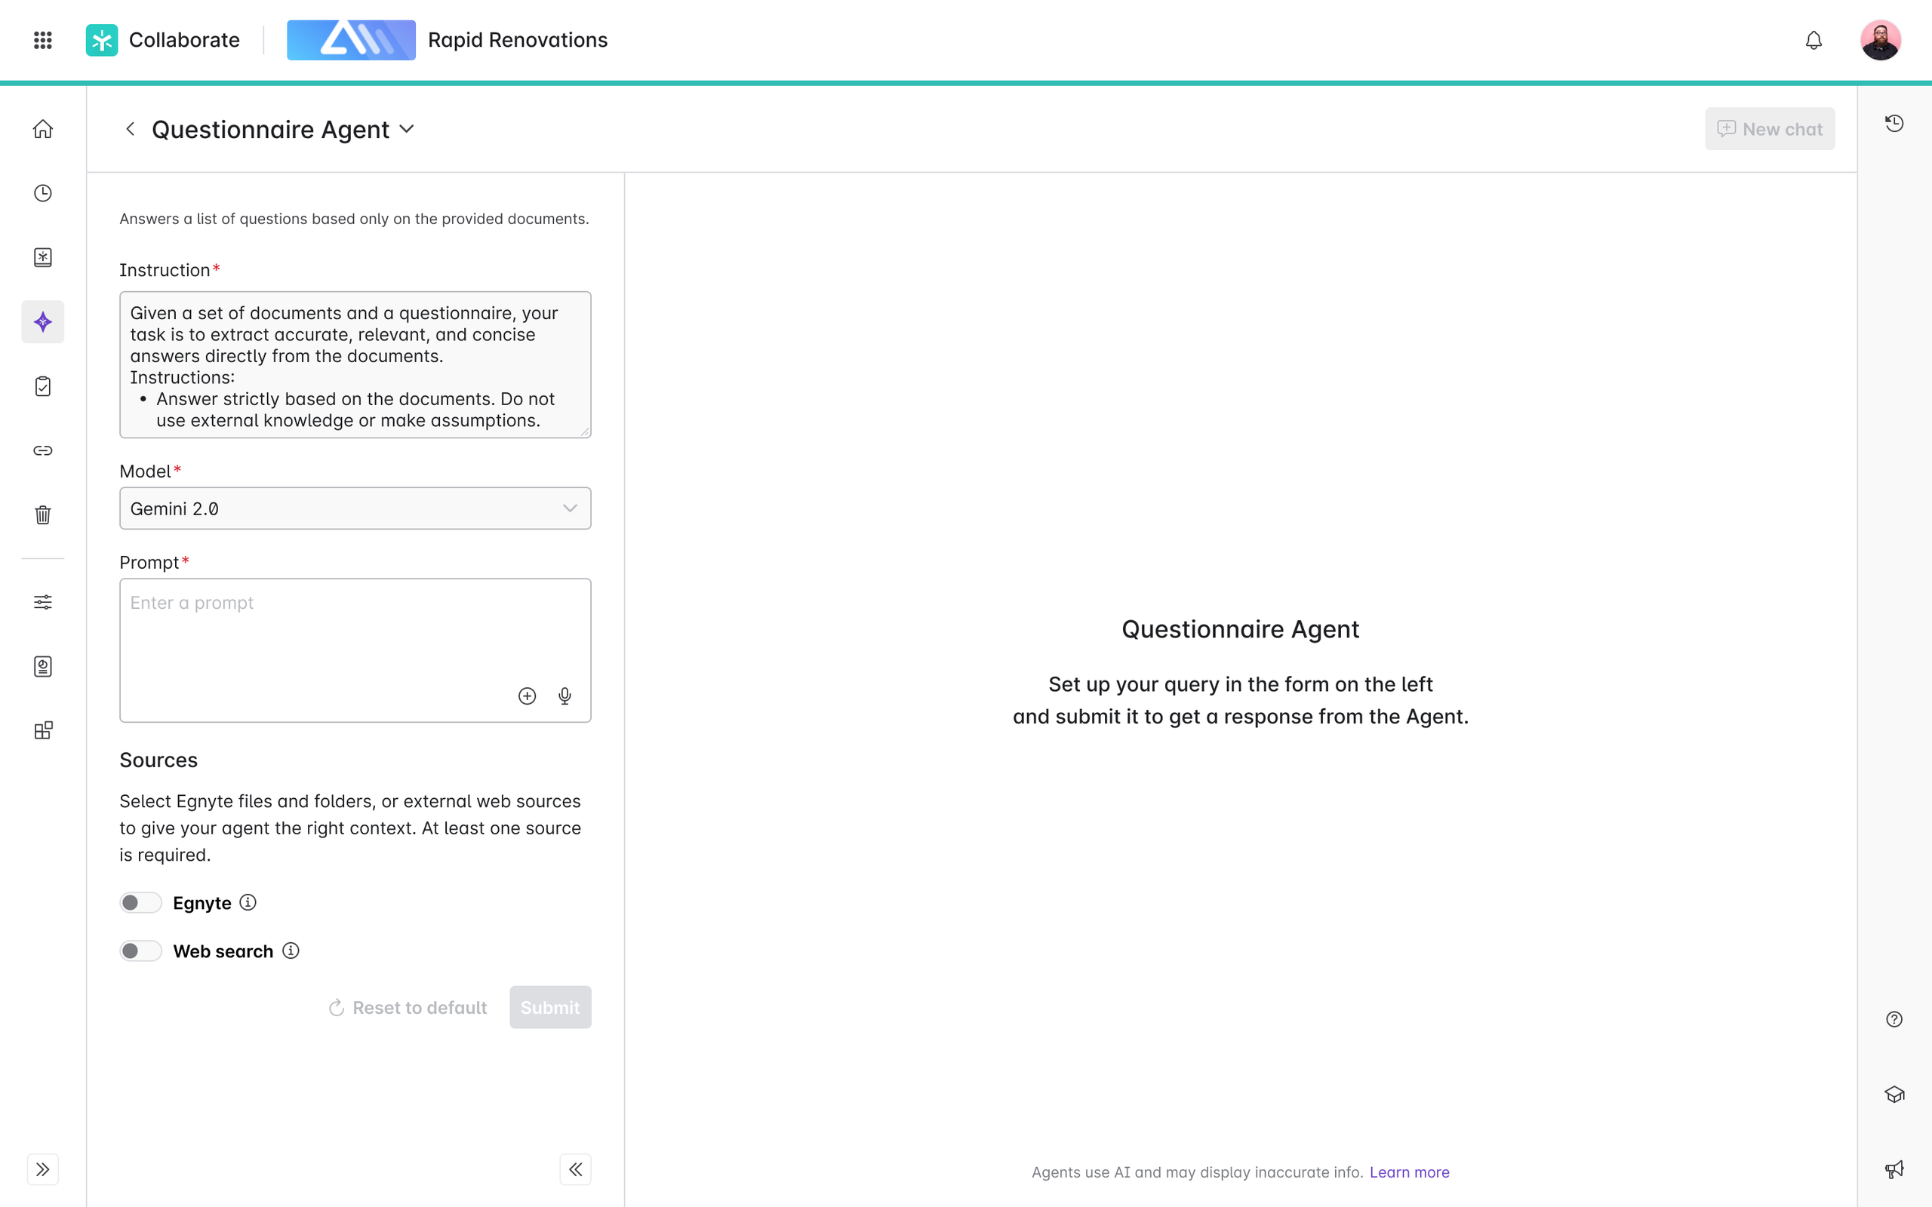
[Agent] Questionnaire Agent (Bryce)
Problem Statement
Users frequently receive lists of questions from clients regarding products, services, and compliances, which require significant time and effort to answer. Often, these questions have already been answered in previous requests or can be found in existing documents. The repetitive nature of this task hinders productivity and wastes valuable time.
User Story
As a user, I want to submit a list of questions (text, excel, pdf, doc) to a Questionnaire Agent and point it to a collection of documents in Egnyte (files or folders) that contain the answers. I expect the Q&A response (text or a document) to be ready for my review, with unanswered questions highlighted for easy review and completion. I should be able to submit the response on Egnyte and further edit it as needed.
Value Statement
• Time Efficiency: Automates the process of finding answers to repetitive questions, significantly reducing the time spent on each information request.
• Enhanced Productivity: Allows users to focus on higher-value tasks by freeing them from the repetitive chore of answering similar questions.
Requirements
https://egnyte.atlassian.net/wiki/spaces/CFS/pages/1471152191/Questionnaire+Agent?force_transition=e7e56be6-04a5-4088-bb89-a71bc2d9bb13
More context in slack channels: #ddq-agent
View in Productboard
CFS-67393
Link to requirements

Slide 48
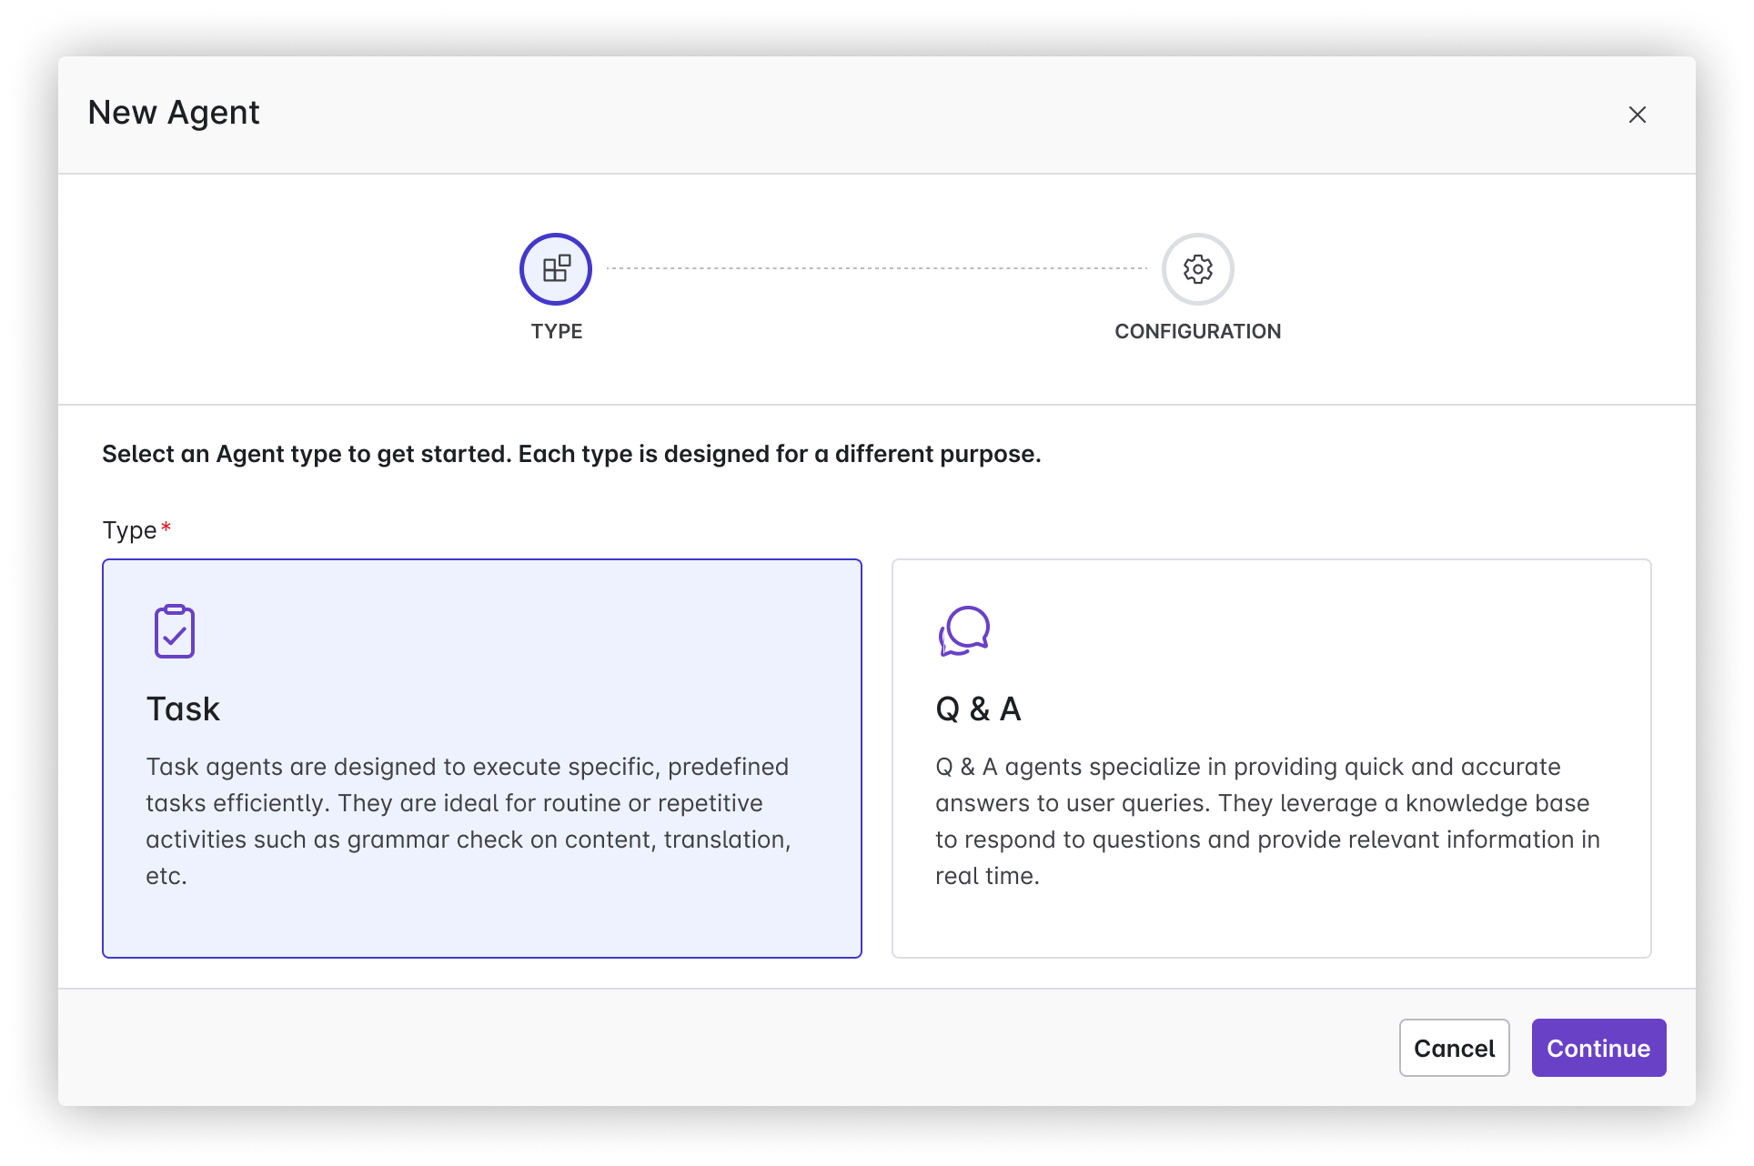
[Agent] Custom Agents in Copilot hub
Problem Statement:
Many businesses are burdened by time-consuming and repetitive tasks that reduce overall productivity and employee engagement. This inefficiency prevents employees from focusing on higher-value work that could contribute more significantly to the company's growth and success.
User story:
As a business owner, I want AI agents to automate repetitive and time-consuming tasks so that my employees can focus on strategic and creative efforts that drive the business forward.
Value Statement:
• 24/7 operational capability, ensuring tasks are completed even outside regular business hours.
• Increased productivity as employees can refocus their time on more valuable activities.
Requirements:https://egnyte.atlassian.net/wiki/spaces/CFS/pages/1227161693/Agents+Introduction+in+Egnyte+Platform+WIP#Create-your-own-Agent
Figma Link
Embedded content
View in Productboard
No Jira Link
Link to requirements

Slide 49
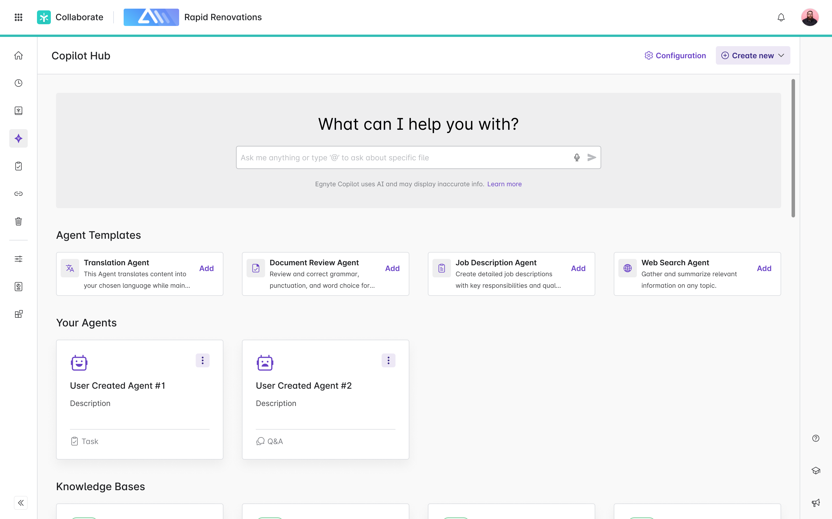
[Agent] Agent Templates in Copilot hub
Problem Statement
New users often face challenges when adopting AI agents due to lack of familiarity and difficulty in configuring them to meet specific needs. This initial barrier can slow down the adoption process, reducing the potential benefits of task automation.
User Story
As a new user of the AI Agents platform, I want pre-configured agent templates available at the start, so that I can quickly set up and begin using these tools without needing extensive customization, thereby experiencing the benefits of automation sooner.
Value Added
• Faster Onboarding: New users can quickly get started with minimal setup time, which reduces the learning curve and speeds up adoption.
• Ease of Use: Pre-configured templates simplify the initial experience, making it less intimidating for users who are not tech-savvy.
• Immediate ROI: Users can achieve immediate productivity gains from automation, showcasing the value of AI agents promptly.
• Flexibility: While templates provide a good starting point, they can be customized later as users become more comfortable with the platform.
• Increased User Satisfaction: Easy access to ready-made solutions enhances user experience and satisfaction, encouraging continued use and exploration of more advanced functionalities.
Agent Template examples:
• Translation Agent:
• Document Review Agent:
• Job Description Creation Agent:
• Web Search Agent:
Requirements
https://egnyte.atlassian.net/wiki/spaces/CFS/pages/1227161693/Agents+Introduction+in+Copilot+Hub
Figma:
https://www.figma.com/design/k96o3kXukaVrAUtsaPhN4H/Egnyte-Platform-Copilot---2025?node-id=24179-230269&t=Rc2JPK6PsbVBlXNe-0
Design:
https://egnyte.atlassian.net/wiki/spaces/CFS/pages/1304788999/Agents+Integration
Feature flags:
*server.SmartAppAgentsPowerUserAccessEnabled*
*server.SmartAppAgentsEnabled*
View in Productboard
CFS-65268
Link to requirements

Slide 50
[Agent] [AEC] Codebooks Agent for AEC
Problem:
Users in the AEC industry require to follow regulations and standards during the design / construction / maintenance of structures and these are stipulated as building codes. These building codes are extremely long, detailed and complex, can vary by local jurisdictions and can change from year to year. Due to these factors, users often face the challenge of finding the right code information pertaining to a project, and using that information to validate project specifications, submittals and other project docs.
Use-Cases:
1. As a project engineer / field engineer, I want to easily get answers to regulatory questions, such ashow many ADA accessible parking spots do I need if my parking lot has 100 total parking spaces?
2. As a project coordinator, I want to easily validate a spec against regulations/codes- validate this stairwell design for fire safety regulation compliance
Description:
We will create a specialized agent, the code books agent, which the admin can configure to read one or more code books at a specific location on their Egnyte domain. Once configured, users can ask questions against the code book agent from the WebUI or desktop
View in Productboard
No Jira Link
Link to requirements

Slide 51
Shore the Core

Slide 52
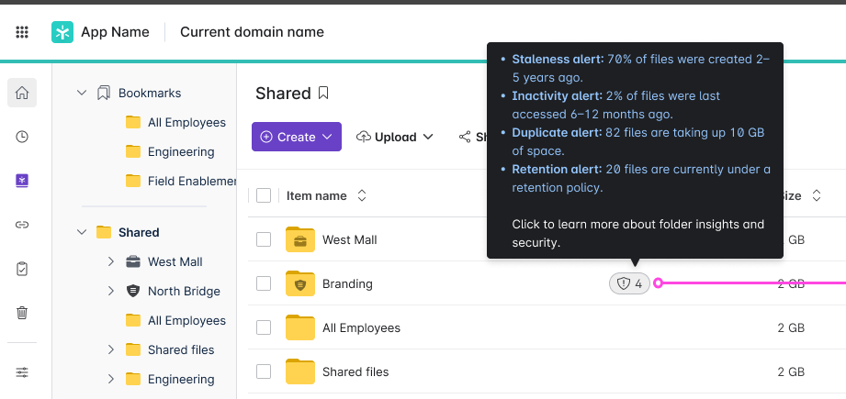
S&G Folder Insights in CFS - Phase 2
Problem StatementAfter providing visibility into the basic Content Lifecycle analytics we want to expand what S&G information we show users in CFS
User Story
As a user, I want to be able to access information about my files without needing to navigate to Secure & Govern
Feature Description:
• Create S&G Insight badge component placed in a Status column of the files list on the folder level
• Badge should show the number of S&G Insights for given folder
• Number of open issues
• number of Sensitive Content
• Percent of files older than 5 years
• Each S&G Insight needs to have a threshold, and only after exceeding this threshold Insight should be shown
Public Summary
The folder insights feature has proven to be a valuable feature to Egnyte customers, with over 30% of eligible domains utilizing the feature in the first 2 months after release, without any type of promotion at all. We want to further increase the value of this feature by both expanding the information it presents and also displaying notifications to users when certain data thresholds are crossed
View in Productboard
DEL-41981
Link to requirements

Slide 53
Enable Power Users Folder Full access to Folders they Create
In order for a power user to have S&G visibility, the power user must have Folder Full access to the individual folders to see issues and sensitive content in their S&G instance.
This feature would delegate Folder Full access to power users for any sub-folder(s) that they create where they have Folder Editor permissions in the parent folder. This would mitigate having the Egnyte Admin user needing to do it on-demand at-request by the Power User and this also empowers the Power User from a CFS perspective to be able to have folder full access to the folders and content that they are creating and populating and as such the ability to delete any unintentionally created files in the folder that they currently only have Folder Editor privileges to.
This feature would result in the following capabilities:
1. Configuration to enable Folder Full access to Folder Editors for folder editor-created folders
In Settings, Configuration - User Types & Roles - under Power User - the following configuration should be enabled -
Configuration (bolded valuesaredefault):
Option A: DelegatedFolder Full rolewhen creating a new folder – Enabled(True,False**)**
Option B: Delegated role when creating a new folder – Picklist: (Folder Full, Folder Owner, None)
2. When the Value is True or Folder Full (depending on Option A or B) for this feature in Settings/Configuration/User Types&Roles/Power User - then any new folder created by a Folder Editor will result in the permission promotion/escalation of the newly created folder for the folder editor who created the folder to Folder Full.
3. This value will be default set to True or Folder Full (depending on Option A or B) for all domains upon release, as there should be minimal impact to existing workflows since the feature upon release will only impact newly created folders and not existing folders.
View in Productboard
CFS-63434
Missing requirements

Slide 54
Implementation of DO and Permission Reviews behaviors
Implementation ofhttps://egnyte.egnyte.com/navigate/file/2b456121-b3cc-4f28-95d3-d2127c979ede
So that Bulk Data Owner permission reviews and other behaviors documented are implemented accordingly
View in Productboard
DEL-45686
Missing requirements

Slide 55
LS Midmarket Capabilities

Slide 56
Support for CAPAs, Deviations, and Event Data
Problem Statement
Our Controlled Document Management application lacks features for managing deviations, CAPA (Corrective and Preventive Actions), and audits. Some potential customers have declined interest in using our app due to the existing gap in our system, and existing customers face challenges in efficiently managing these quality processes within Egnyte. This feature will unblock existing customers and allow us to engage in sales activities much more competitively.
User Story
As a member of my company's Quality team, I want to manage CAPAs, deviations, and audits using Egnyte's Controlled Docs application.
Feature Description
This feature allows Controlled Docs customers to manage deviations, CAPAs, and audits in Controlled Docs by enabling the creation of custom categories with configurable document statuses.
View in Productboard
LS-4286
Link to requirements

Slide 57
NGP for Customers

Slide 58
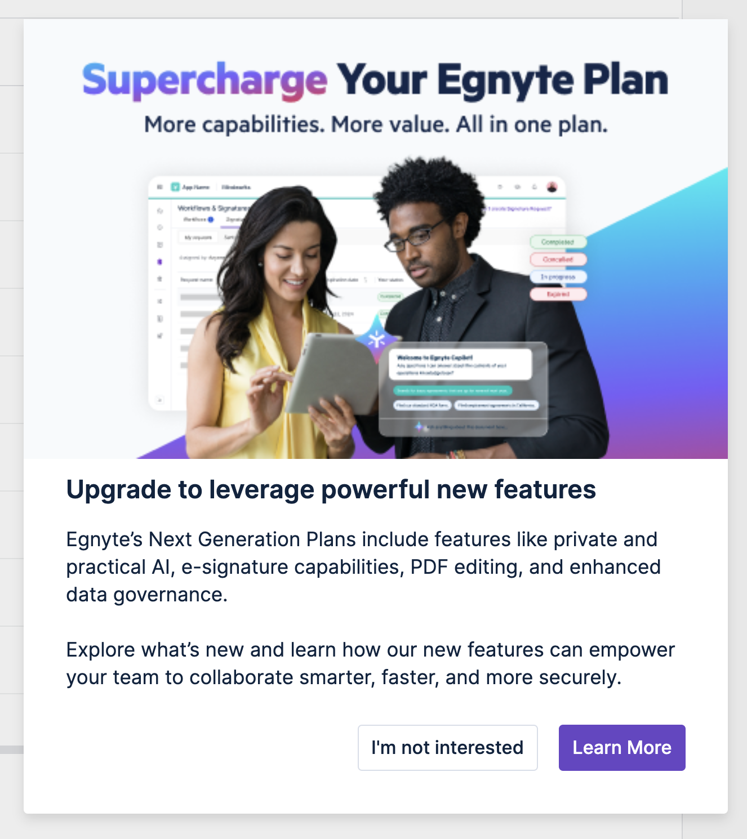
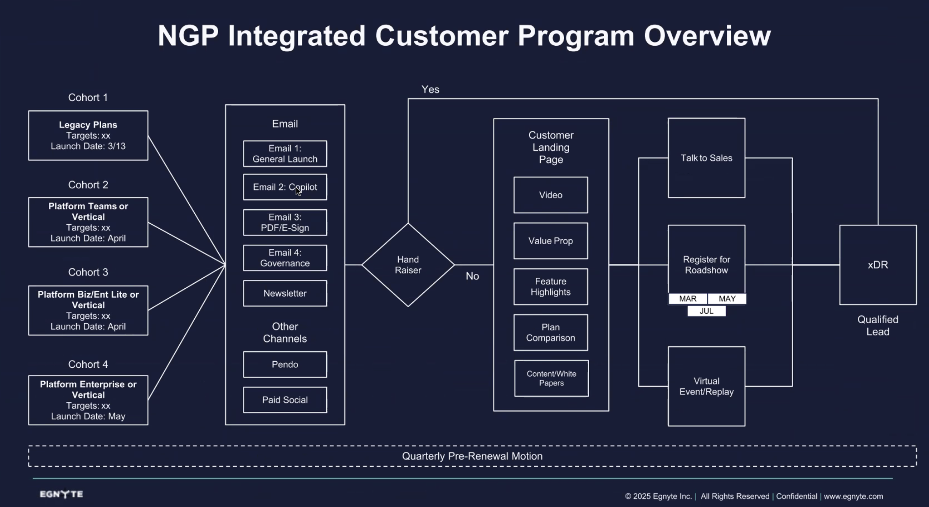
NGP Upsell from G3 and Prior
In collaboration with Marketing, we will launch a series of Pendo Upsell campaigns aligned to other marketing efforts.
View in Productboard
GR-562
Link to requirements

Slide 59
Other Plans Page for Customers: Trials
Problem Statement:Paying customers cannot view or trial plans outside their current plan set, including higher-tier and industry-specific plans, limiting transparency, upgrade opportunities, and the ability to discover new capabilities.
User StoryAs a paying customer, I want to explore and trial plans outside my current plan set to evaluate options with more value or a better fit without disrupting my existing services.
Feature Description
• Display other eligible plans outside the customer’s current plan set, including industry-specific offerings.
• Enable customers to start a self-serve trial of a higher-tier plan on their existing domain without affecting current functionality.
• Communicate feature differences and added value to support upgrade consideration.
View in Productboard
APPS-13646
Link to requirements

Slide 60
Other Plans Page for Customers: Backend & Analytics Support
Problem StatementTo support customers' Other Plans experience, backend systems and analytics must be enhanced to ensure accurate configuration, tracking, and reporting. Metadata updates are essential to properly display the correct plans and features in the right order, while analytics and system integrations ensure billing alignment and actionable insights.
User StoryAs a product and analytics stakeholder, I want backend systems and metadata updated to support plan trial functionality and data tracking. This will ensure that customers see the right plans and features and that we can ensure accurate billing and usage insights.
Feature Description
• Update metadata to configure the Other Plans Page, determining which plans and features appear and in what order.
• Enhance backend systems (e.g., domain info and billing app) to support trial status, plan changes, and customer state tracking.
• Extend analytics coverage by adding new events and fields in BQ and Mixpanel, and push PQL signals into SFDC for Sales engagement.
View in Productboard
APPS-13647
Link to requirements

Slide 61
[PLG] Trial Onboarding Evolution (Milestone 5)
• Create a walkthrough for Ask & KB. Take the user to Ask/Copilot and prompt them to click on buttons to get the experience.
• Open a document, click on it, go to Ask and ask a question. -
• Go to Copilot Hub, click on Create KB, go through the workflow and stop after submitting the OK button. Show the video on how to use KB once it is active.
• Video asset for Contracts Analyzer
• Animate the confetti all over the screen when user gets a Reward.
• New Quick Tip Videos
• Auto Remediation
• Project Folders (updated)
• Co-edit (updated)
• User Management & Permissions
• Auto-Remediation walkthrough
• Life Science: Include Controlled Documents app in the App Picker
View in Productboard
GR-661
Missing requirements

Slide 62
Plan Assistant
Problem Statement
Admins are responsible for managing their organization’s plan, billing, and account configuration, but they currently have no way to use AI to access this information or take action. Instead, they rely on static pages or support interactions, which limits their understanding of what features they have, what’s available, and how to upgrade.
At the same time, many users are not being exposed to Egnyte’s AI functionality—either because they’re on a legacy plan that doesn’t include it, or they haven’t purchased the optional add-on available in standard plans. This is a missed opportunity to demonstrate the value of AI in a real, actionable context.
By utilizing AI to assist users in interacting with their account data, understanding their plan, inquiring about available features, and exploring upgrades, we can effectively demonstrate the value of Egnyte’s Next Gen (AI-powered) plans in a way that is both helpful and relevant. It allows users to experience the benefits of AI functionality, even if their current plan doesn’t include it, and creates a natural path toward upgrading to a plan where these capabilities are fully integrated.
User Story
As an admin, I want to utilize AI to ask questions and take action on my plan and billing details, so that I can understand what I currently have, see what’s available, and upgrade to a plan that includes the capabilities I need.
Feature Description
• Use AI to help admins understand which plan they’re on and what AI capabilities are available, based on whether they’re on a legacy plan, a standard plan (as an add-on), or an AI-powered plan.
• Support actions like starting trials of add-ons or higher-tier plans, performing upgrades to AI-powered plans, and updating account details, with proper confirmation and downstream system logging
• Deliver this experience to all admins in the Subscription section to expose users to Egnyte’s AI functionality and guide them toward Next Gen plans where these capabilities are natively available.
View in Productboard
APPS-13943
Link to requirements

Slide 63
CMMC Compliance

Slide 64
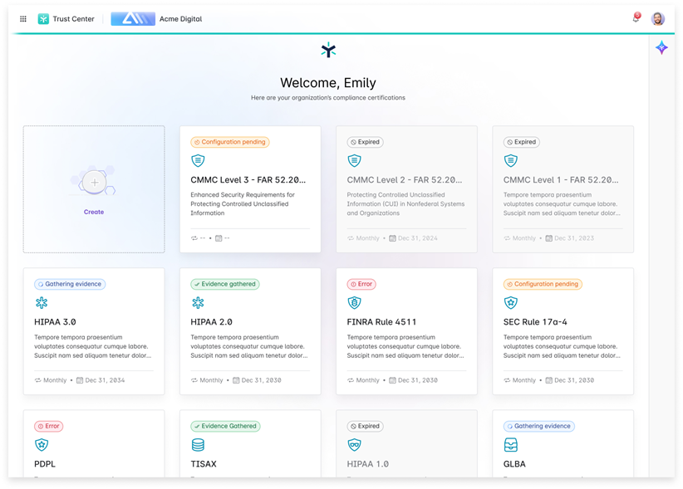
Trust Center for CMMC Level 2
Problem Statement
CMMC Level 2 is a key compliance mandate for DoD contractors and sub-contractors. Proving CMMC Level 2 compliance ensures that DoD contractors and sub-contractors can participate in DoD RFPs. Compliance Managers are required to collect evidence (or artifacts) for all CMMC Level 2 controls. This is a time and resource intensive effort often leading to human errors, guess work, and rework. Compliance Managers greatly benefit if they had a mechanism to collect such evidence automatically and on a recurring schedule (to prove continuous compliance).
User Story
As a Compliance Manager, I want to collect evidence for CMMC Level 2 controls, so that I can be CMMC audit-ready.
Feature Description
This feature includes:
• Content pack for CMMC Level 2 (Control Number, Control Family, and Control Text)
• Mapping CMMC Level 2 controls to Egnyte capabilities
• Collecting evidence for CMMC Level 2 controls
• Integration into Trust Center landing page
View in Productboard
DEL-44555
Link to requirements

Slide 65
Top Customer Requests

Slide 66
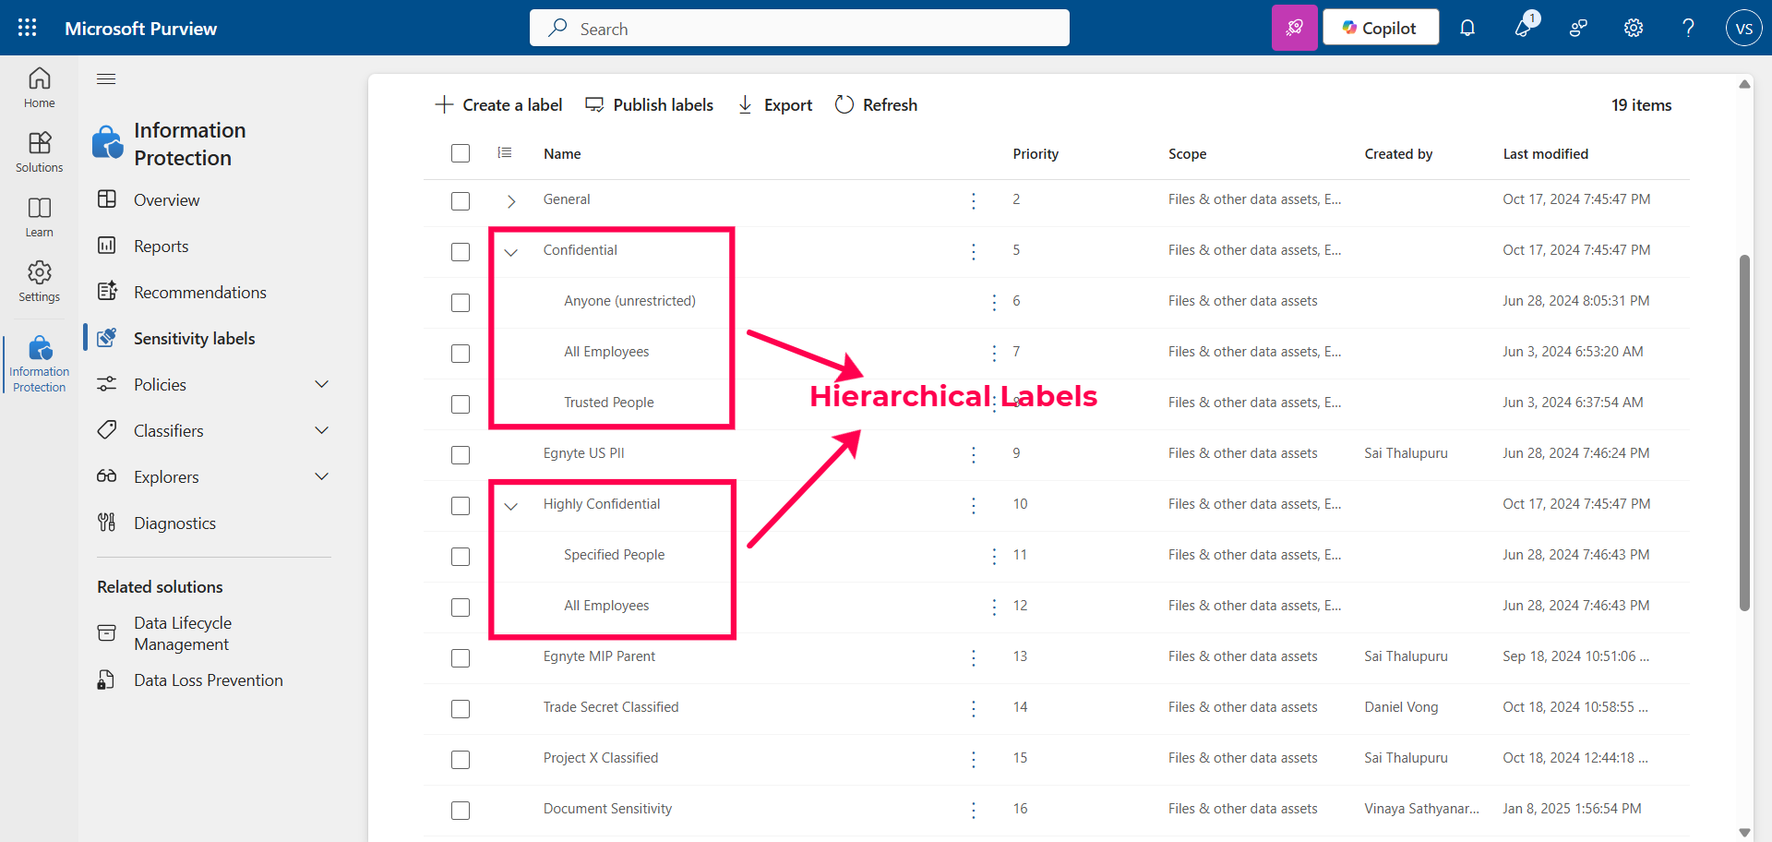
Purview labeling - Support for hierarchical labels
Problem Statement
Microsoft Purview labels can be configured with a hierarchy. Egnyte does not currently support importing hierarchical Purview-labels. This impacts customers who have already configured hierarchical labels. This hierarchy is typically configured by administrators in the Microsoft Purview
User Story
As a Security Administrator, I want to apply a Purview label from a hierarchy on a document so that I can label sensitive content correctly.
Feature Description
• Import hierarchical labels from Purview - both parent and child labels shall be imported and made available for mapping in Egnyte
View in Productboard
DEL-44656
Link to requirements

Slide 67
Systems to support $500M Business

Slide 68
Sales Initiated Customer Spillover
Problem Statement:
We have introduced the functionality of creating and deploying a domain onto a plan without having to start a trial. We now want to expand that functionality and iterate to make the process smoother.
User Story:
As a seller, I want to have my customer use a domain without starting a trial, so that they can use the Egnyte product faster.
Feature Description:
• Expanding automated deployment automation
• Improving notification & provisioning auditing
View in Productboard
APPS-13663
Link to requirements

Slide 69
Placeholder Initiative

Slide 70
MSP RD - First child domain user edge cases
Problem Statement
Previously, a feature to create the 1st administrator of a domain as a service account automatically has been prepared. It covers the main use cases:
1. starting a trial
2. creating a service account
The feature changes the way of starting child domains for the partner and allowed to access the domains free of charge for the Administrator user.
This is to continue the effort for identified edge cases.
User Story
As an Egnyte staff user I want to manage a Pax8 MSP so that Egnyte can sell products through a Distributor.
Feature Description
• deactivating the reseller user who created the trial domain and assigning a different user
• convertins a direct domain to MSP domain
• converting an MSP domain to direct domain
• clean up for the feature once it is rolled out in full
View in Productboard
APPS-13482
Link to requirements

Slide 71
Reverting Storage Per User for MSP Platform Enterprise & Platform Enterprise Lite Plans
Problem Statement:
We have recently made changes to the amount storage per user is given to new MSPs. However, through initial research we found that this configuration was given to older MSPs at a lower price point.
User Story:
As a Sales Leader, I want to make sure older MSP plans have the proper storage amount per user so that there's a clear path for upselling to higher plans.
Feature Description:
• Correct minimum storage amounts on selected PVIs
View in Productboard
APPS-13022
Link to requirements

Slide 72
Update ‘NFR' to 'Demo’ in MSP Reseller Dashboard customer facing UI
Problem Statement
Currently the NFR domain is created for each new MSP partner in the onboarding process and it is used as a test environment for each partner.
With the current name NFR Not For Resale for the free domain the partners are confused. Some of them think it is a domain for their internal use and expect to have more free resources and enable features/add-ons for them for free. Each time it needs to be explained to them or worst case scenario - we need to provide free resources.
Renaming NFR to demo is the first step on the way to better support partners in demonstrating Egnyte offer.
The newly created MSP Partner Program distinguishes two ways of rewarding a partner - granting a free domain for internal partner use and setting up a demo domain they can use to present the plans and features/add-ons to the end customers. Strategically we aim to offer both but based on different conditions.
User Story
As an MSP I want to be clear about the purpose of the tool that Egnyte provides.
Feature Description
1. Update ‘NFR' to 'Demo’ in MSP Reseller Dashboard customer facing UI
1. tab name
2. welcome email sent
3. account setup page
View in Productboard
APPS-13878
Link to requirements

Slide 73
Enhanced AI copilot

Slide 74
S&G Sensitive Content Skill
Followed by CLM, we want the users to now be able to query Sensitive Content details at the folder level. More details specific concerning the extent of results that can be extracted is documented in the linked ticket.
View in Productboard
DEL-44323
Link to requirements

Slide 75
External Replication

Slide 76
External Replication for MSPs
Simplify the "backup" experience for MSPs to create a copy of Egnyte content to S3/Wasabi/Azure. This is a mix of UI/UX changes and improving supportability on ExtRep to troubleshoot issues.
View in Productboard
No Jira Link
Missing requirements

Slide 77
Large Scale Replication
Improve scalability of External Replication to replicate over 150 TB of data to S3 or Azure
View in Productboard
No Jira Link
Missing requirements

Slide 78
AECO Business Hub

Slide 79
Bulk Sync Projects - ACC & Procore to Egnyte
The work here will build on the work of two other projects:
1. Procore Integration, currently setup with Documents and Photos two-way sync
1. Procore Metadata PRD
2. Photo Sync PRD
2. ACC Integration, currently setup just to sync from Documents
The use case is to reduce the time it takes for one company (e.g. ARCO) to setup all 50+ projects on their Procore, ACC, and other softwares to Egnyte. Today the user has to go in and individually setup a sync from Procore to Egnyte or from ACC to Egnyte, and then has to do that for the other 50+ projects they are on.
The hope with this feature is that
1) companies will want to sync their data
2) that users will increase usage of Egnyte since their data will be in Egnyte.
View in Productboard
No Jira Link
Link to requirements

